Slide 1

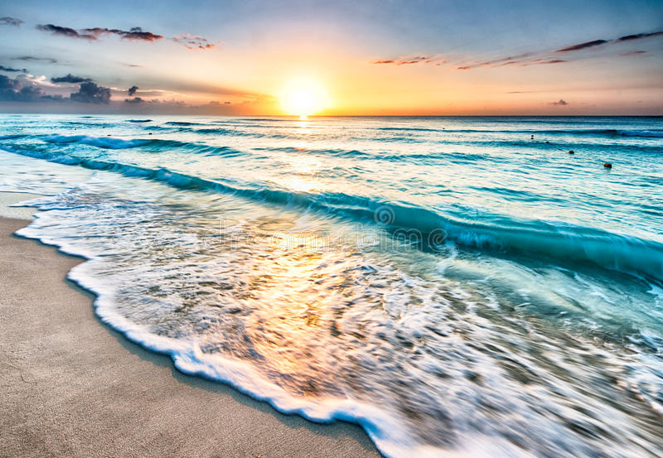
Smart Beach by Bruce County
for Sanjeev Kumar
Sanjeev Kumar - Professor
Brunilda Xhaferllari – Project Manager
Rich Freeman – Faculty Mentor
AI Team:
Janvi Patel
Fangji Chen
Scaria Ouseph Kurian
Date: 29-03-2023
Notes:
Image: 12019 (2016) Ocean waves crashing on shore during daytime https://pixabay.com/photos/beach-sea-sunset-sun-sunlight-1751455/

Slide 2
Architecture updates
V3

Slide 3
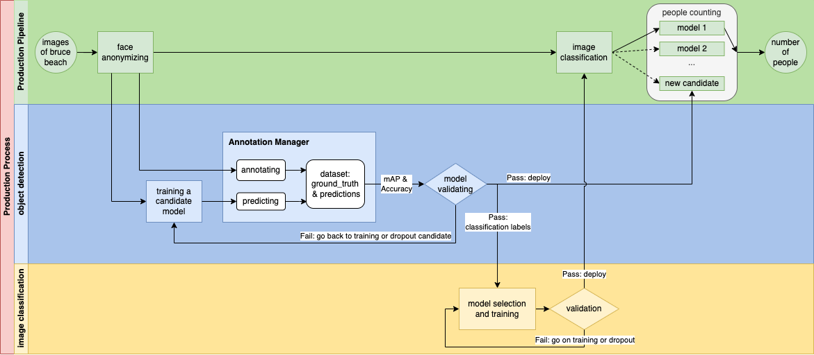

Slide 4
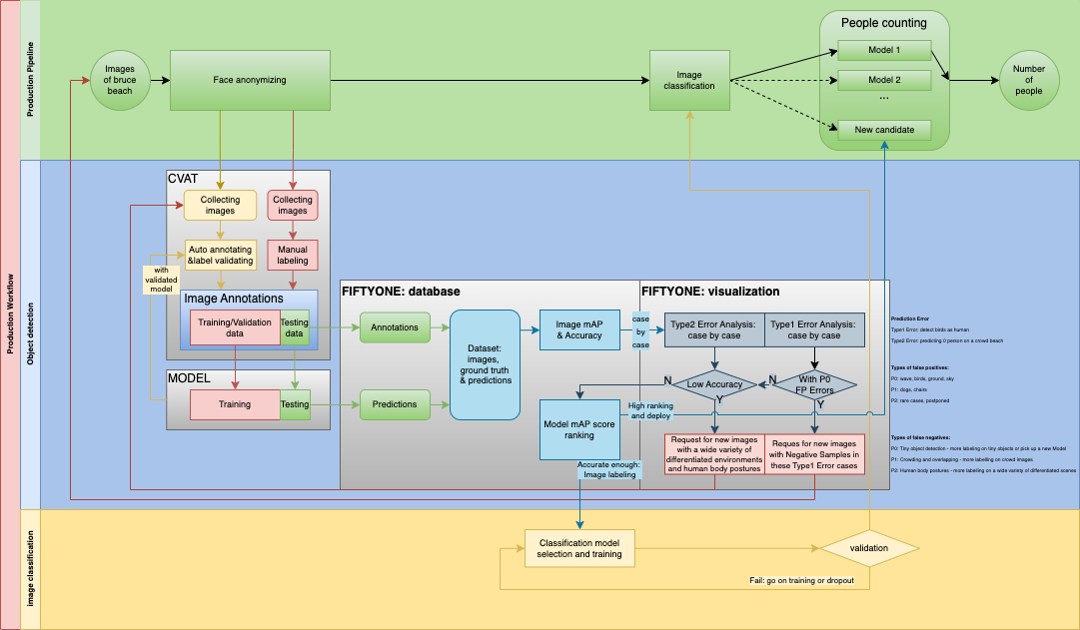

Slide 5
Image Annotating
P0: wave, birds, ground, sky
P1: dogs, chairs
P2: rare cases, will be postponed

Slide 6

Additional activities since the last report
Work:
Annotating all the images of the data provided last week.
Working on documentation of the project.
Training models on new data to get a final accuracy.
Notes:
Padrinan, Miguel (n.d.). Email blocks on Gray Surface. Accessed on January 16th, 2023 from https://www.pexels.com/photo/email-blocks-on-gray-surface-1591062/

Slide 7
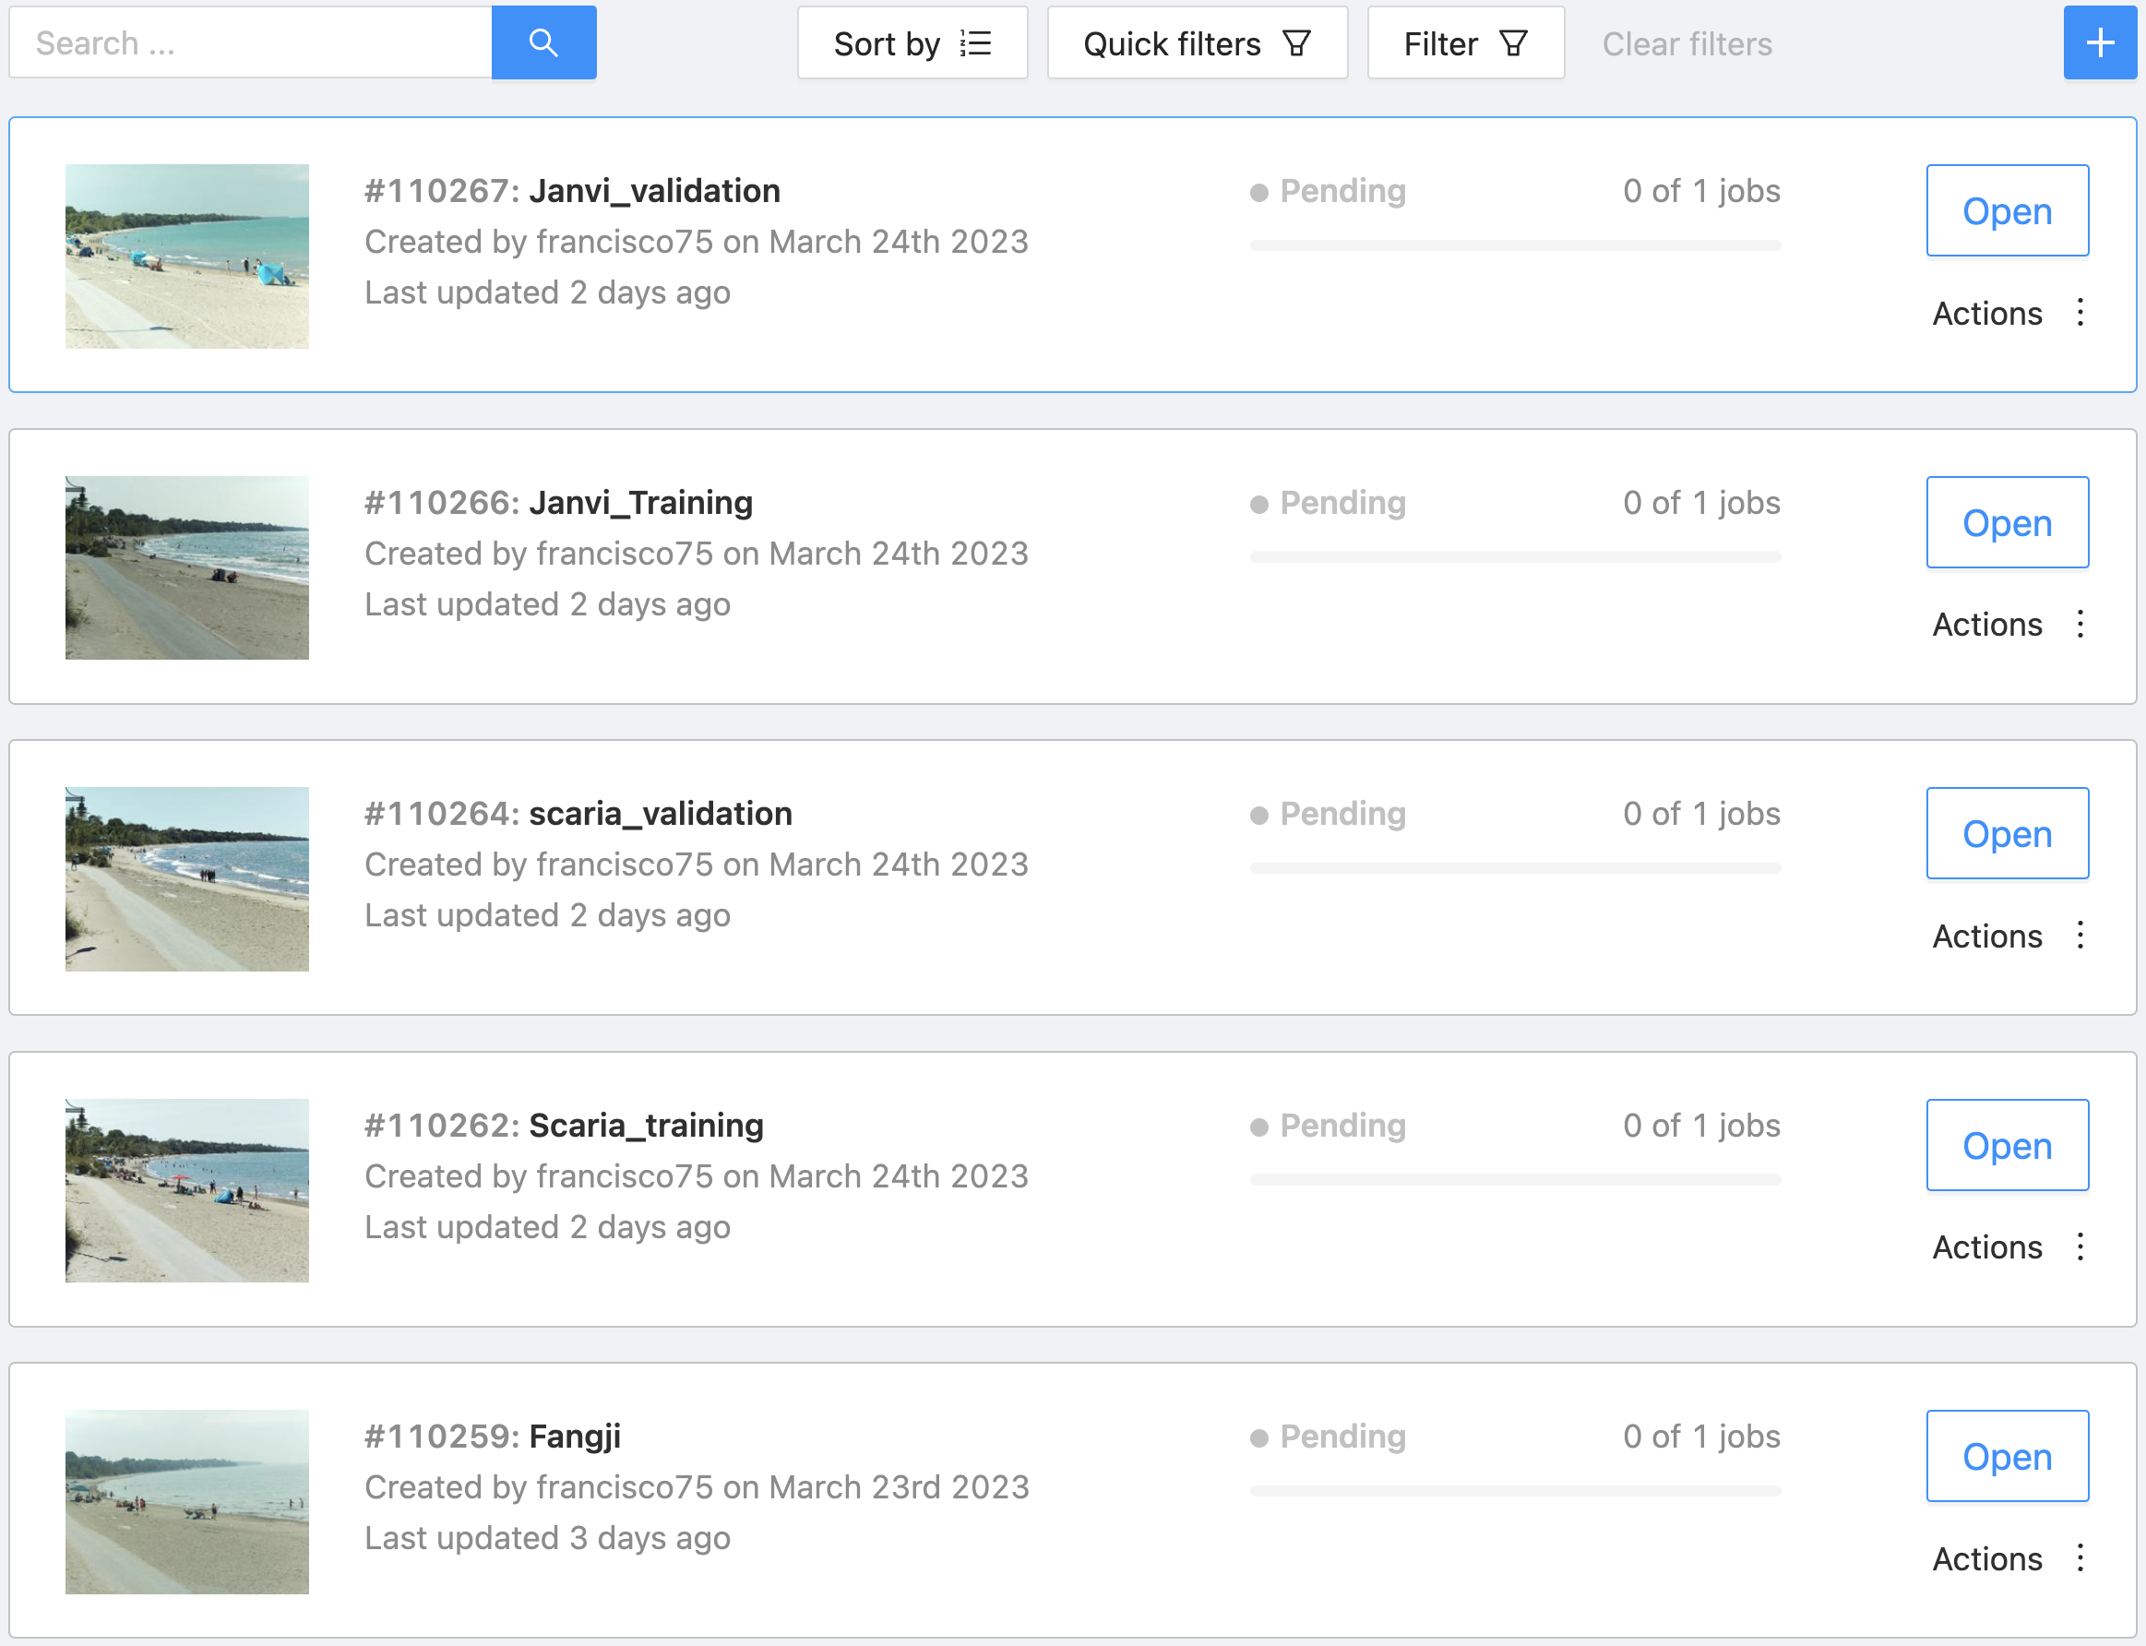
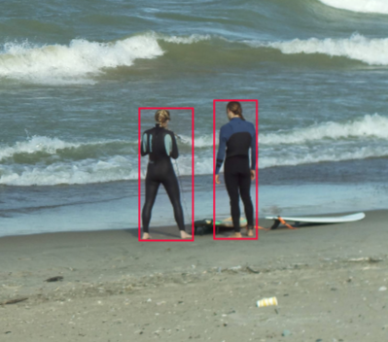
We have divided the tasks into parts to work faster.
As shown above.

Slide 8
Model training

Slide 10
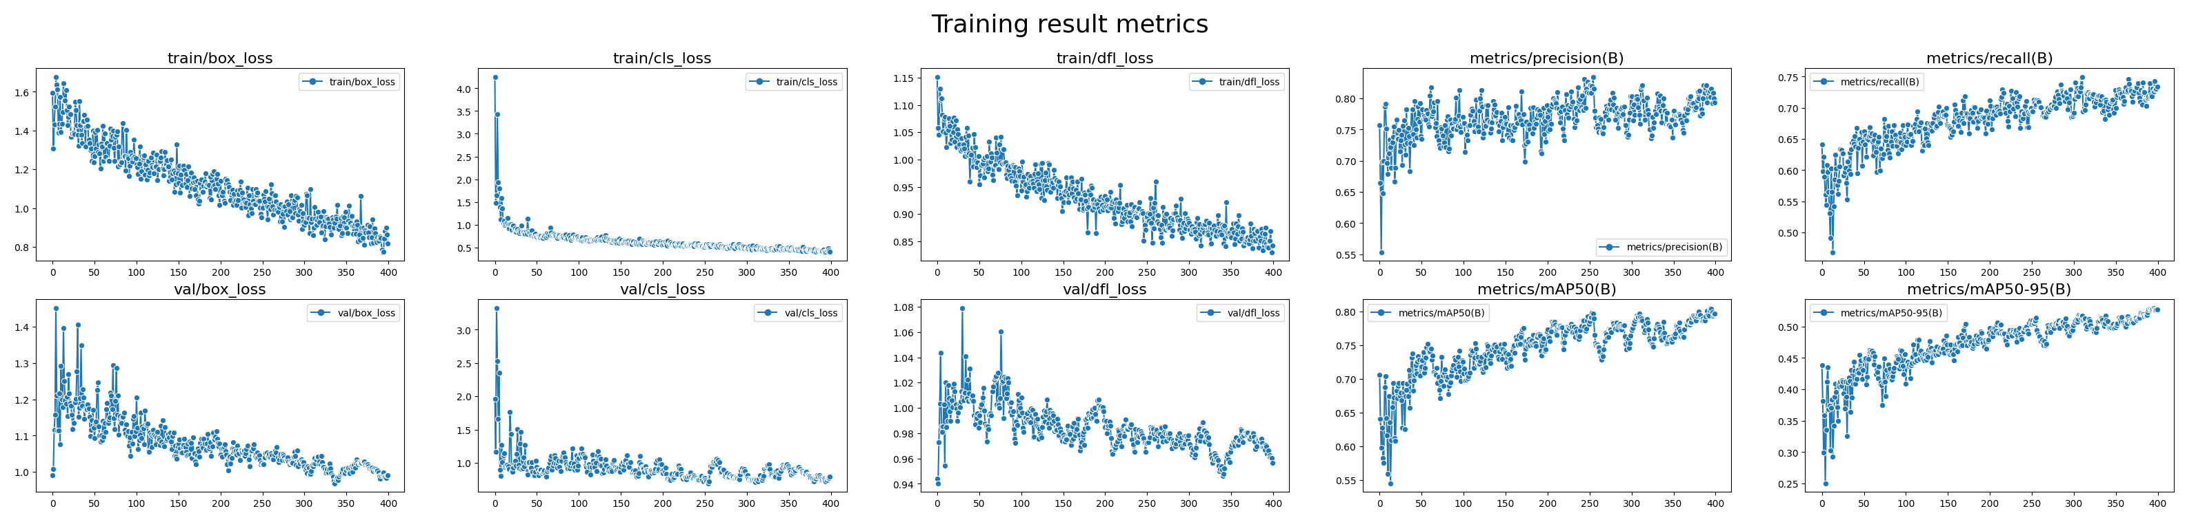
Compared to the previous 35 training images, now with over 25 hours work of annotating, we got a training dataset with 158 images and a validation dataset with 73 images.
Over 12k manual annotated bounding boxes.
The training results are visualized in the image shown above.

Slide 12
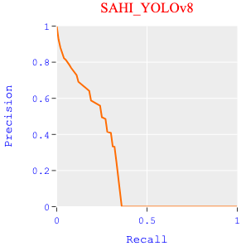
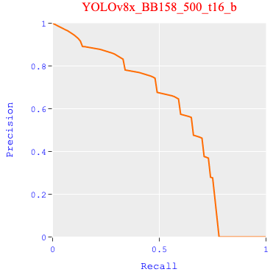
Power of Training
Actually, this special model only has the pieces of knowledge that came from the two cameras.
The training data only includes images in a short period of time: from August to October of 2022.
Any items that the model had never seen will trigger a type 1 error.

Slide 13
Annotations and Prediction errors
What is a bad case?
P0: wave, birds, ground, sky
P1: dogs, chairs, dead-wood bringing by the storm
P2: rare cases, will be postponed

Slide 14
Compare prediction with annotations
on training & validation datasets.
(Actually, we should use the test dataset instead. But we didn’t prepare enough images for that.)

Slide 15
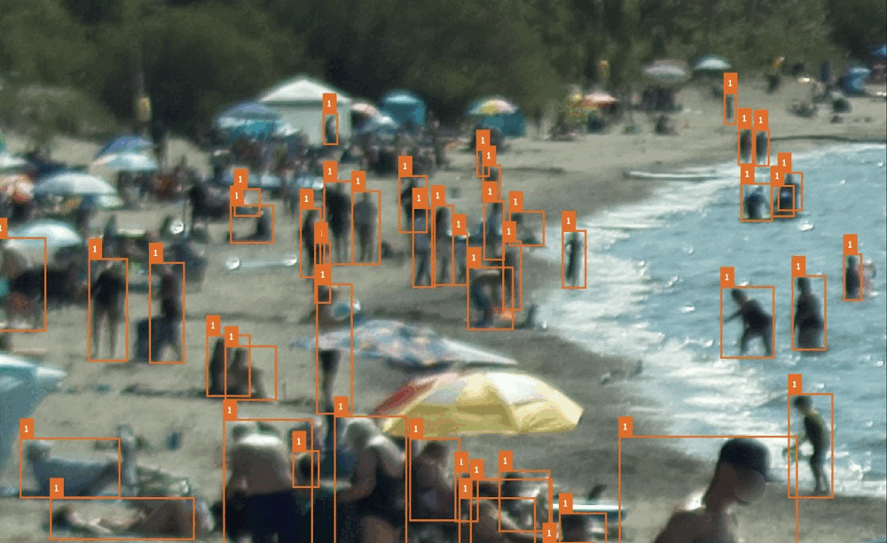
Missed annotations
Bad prediction:
beach umbrella
Bad annotation:
swim ring
Bad prediction:
swim rings

Slide 16
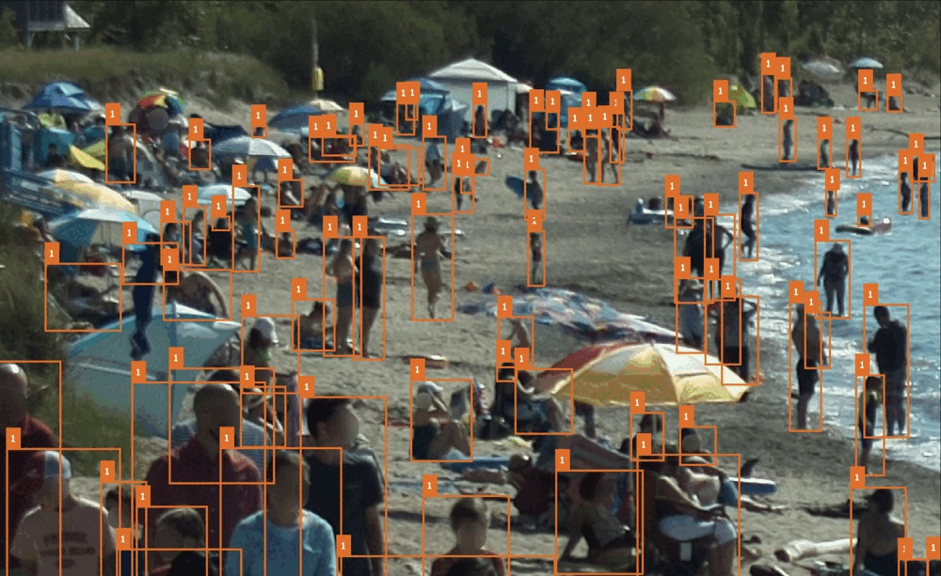
Missed annotations
Bad annotation:
Auto annotating
Bad annotation:
Auto annotating
Bad annotation:
Auto annotating

Slide 17
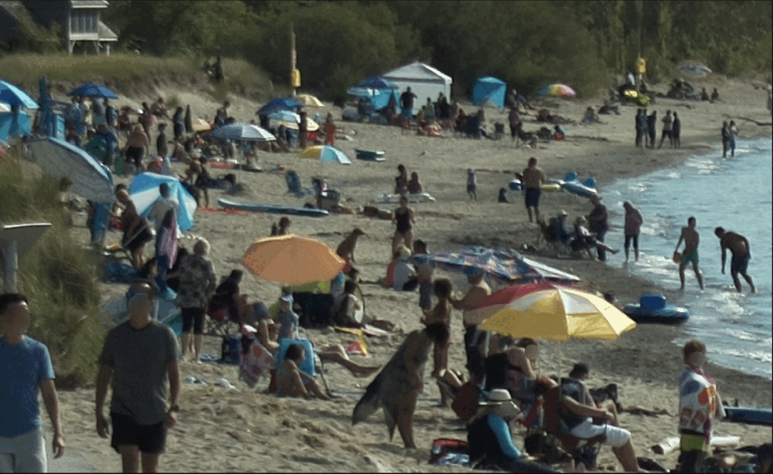
Bad annotation:
Auto annotating
Bad annotation:
dog
Bad annotation:
Crowding
Bad prediction:
Crowding
Bad prediction:
Dog, chair

Slide 18
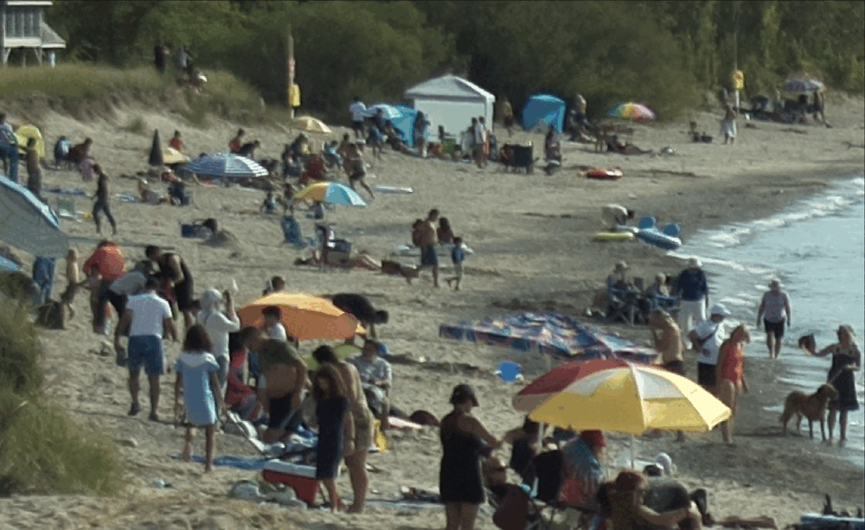
Missing
Bad annotation
Bad annotation
Missing
Bad annotation:
Wrong area of a bounding box
Missing
Bad annotation
Missing

Slide 19
Model validating

Slide 20
Get some clues about which image to see and examine by computing image metrics.

Slide 21
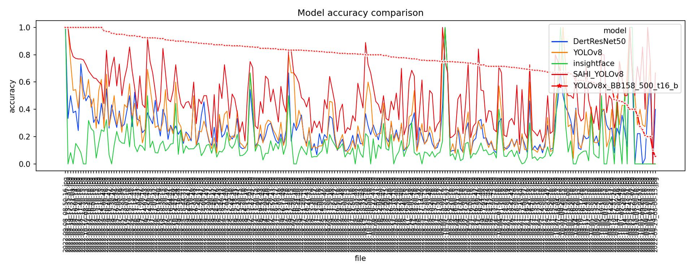
In most of the case, the latest model shows the best accuracy than all the other candidates.
Some bad case are found in this plot due to the reason of the lack of training data: the model needs a wider range of training cases to learn what are the real patterns of people.

Slide 22
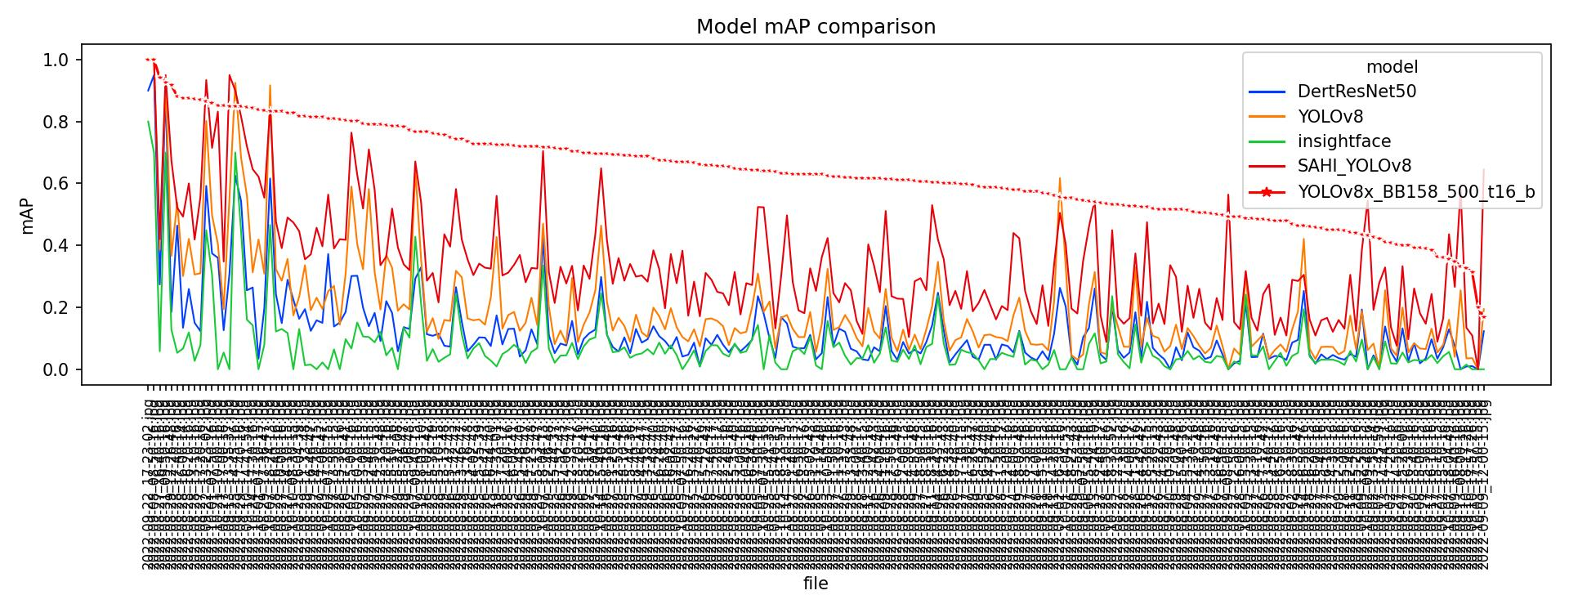
The same issue can be seen in this mAP score metric plot

Slide 23
Annotations and Prediction errors
Keep going

Slide 24
Compare prediction with annotations
on training & validation datasets.
(Actually, we should use the test dataset instead. But we didn’t prepare enough images for that.)

Slide 25
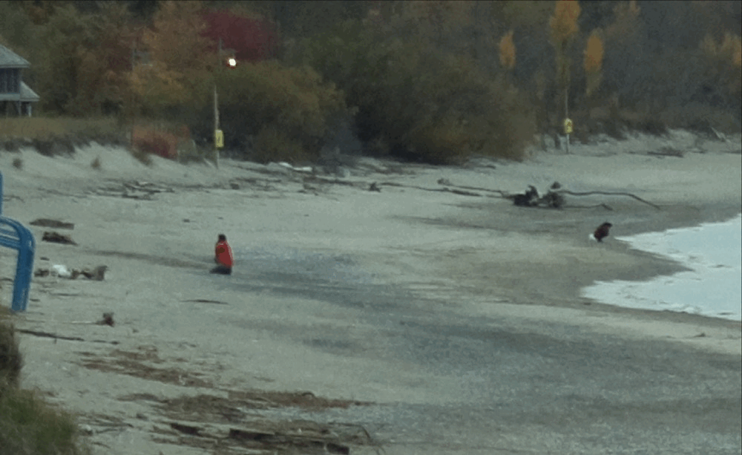
Bad annotation:
Wrong area of a bounding box
Dead-wood
Squatting girl
Dead-wood

Slide 26
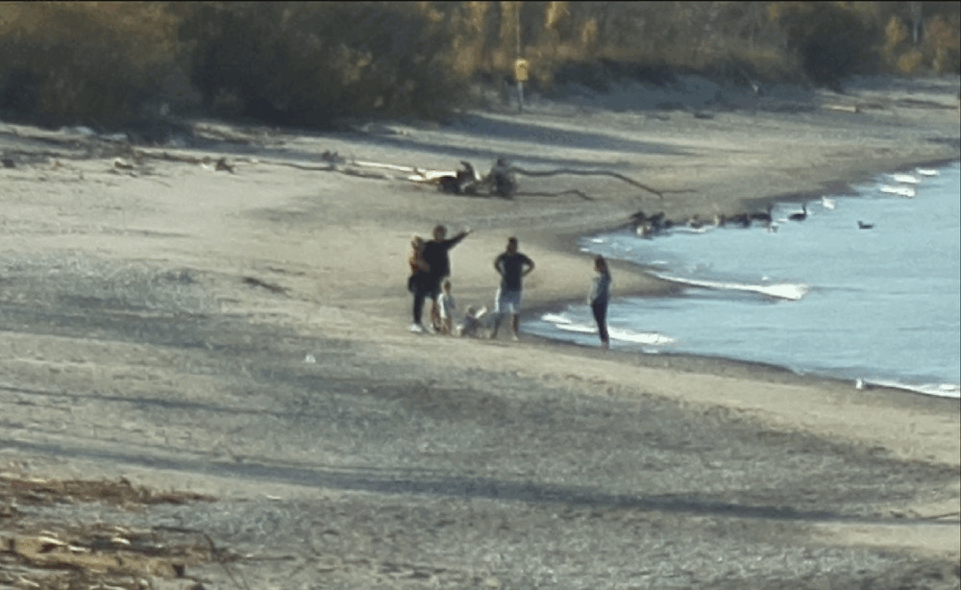
Bad prediction:
recognized a dog as a baby squatting playing sands

Slide 27
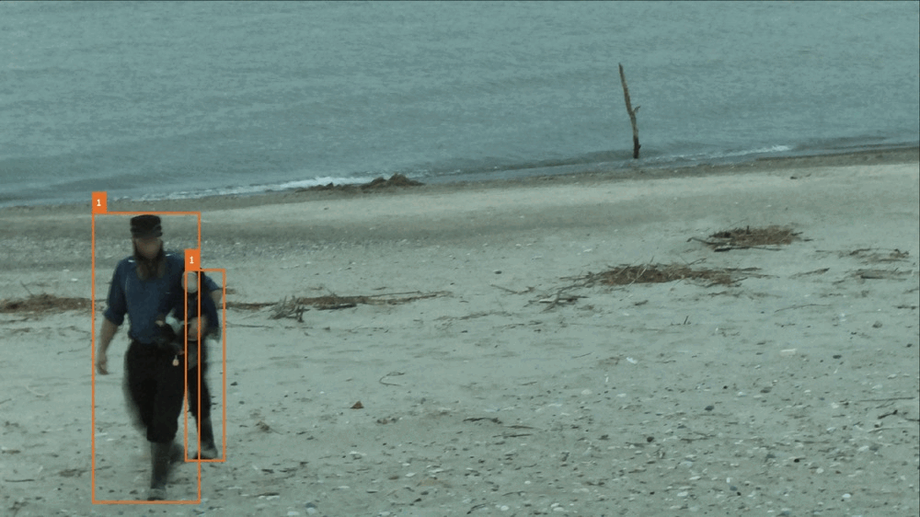
Bad prediction:
Tiny rock

Slide 28
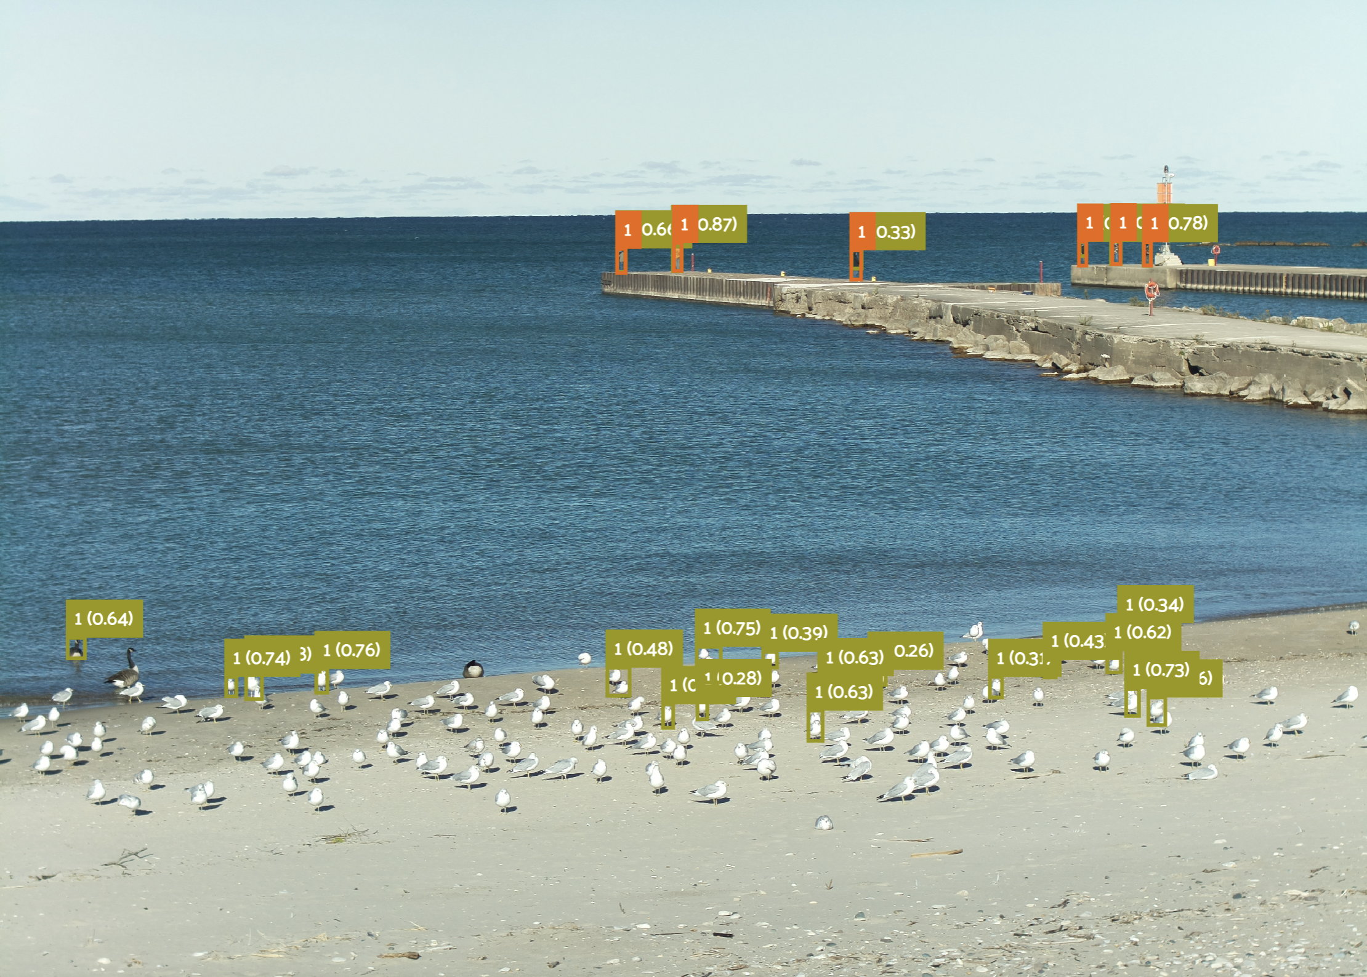
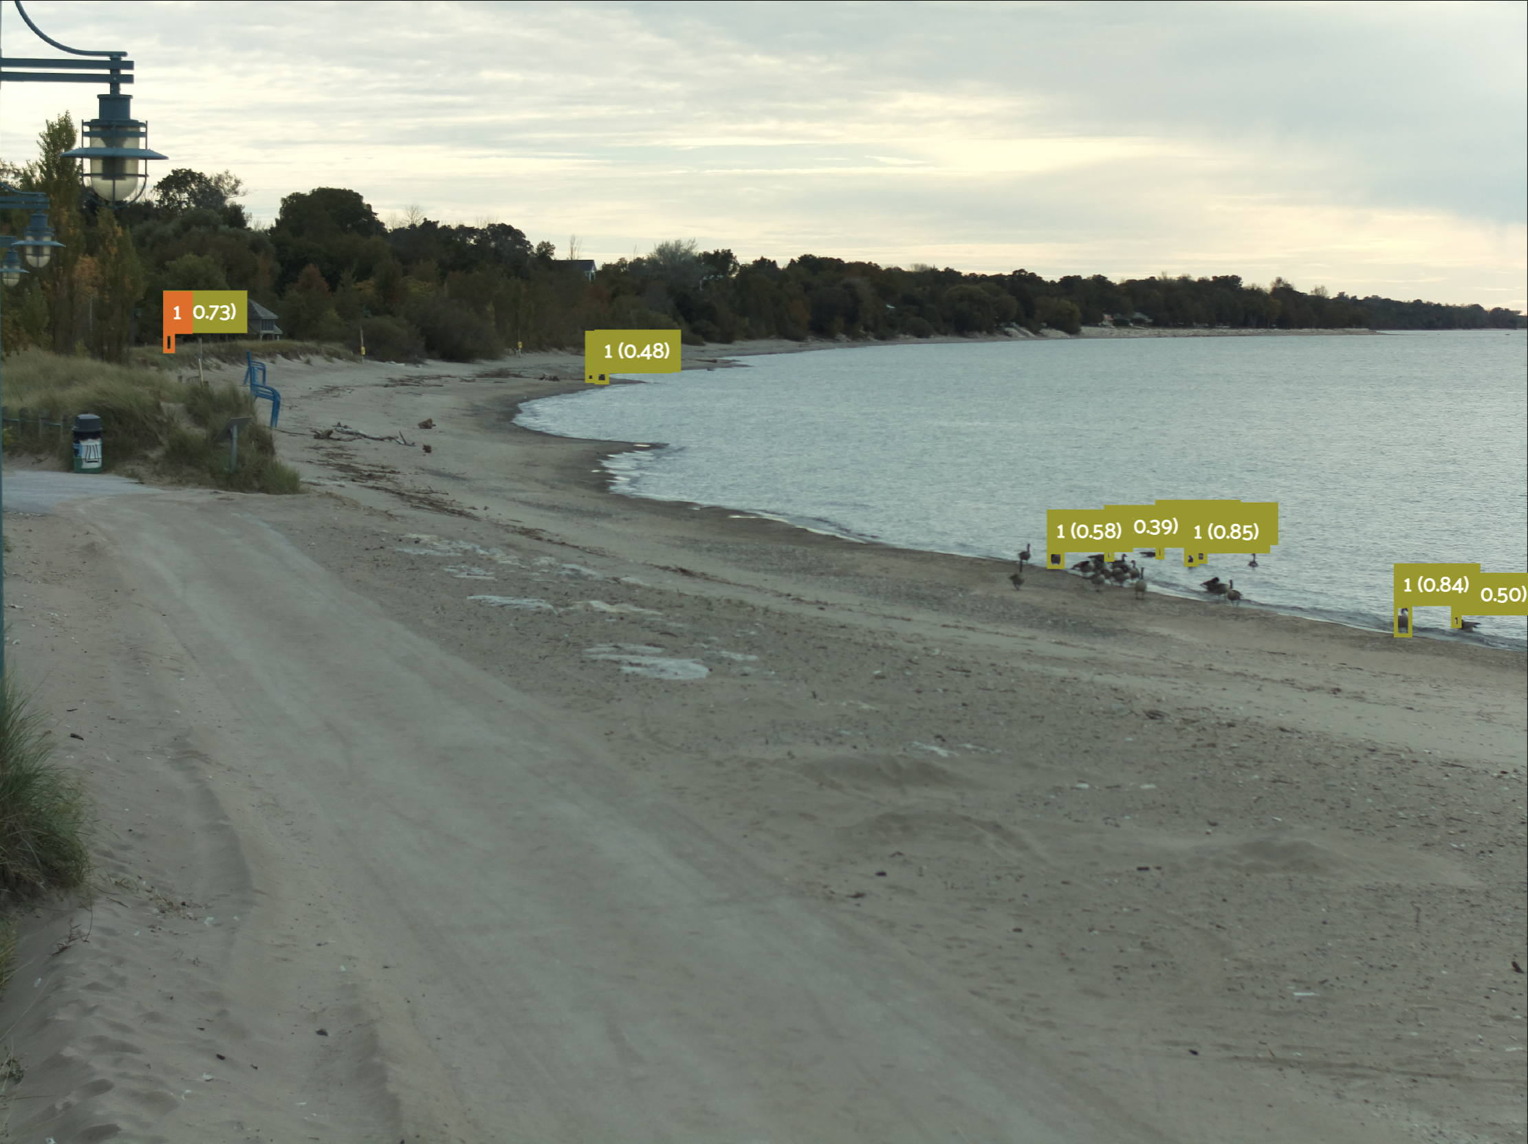
How bad the model performs depends on how empty the shore is...
This is because most of the training data are with crowded people on shore and inshore. A wide range of negative samples is crucial to train a robust model.

Slide 29
Requirements of a robust model
A robust model required a far more diversified and accurate training dataset.
AKA, we need a large-scale image annotation benchmark of Bruce Beach.
More cameras, more images, maybe across several years and tens of thousands of annotated images.

Slide 30
Produce new classification label with a validated model
Even though it‘s not quite ideal, continuing in this direction to enlarge our annotated dataset and training models is the proper thing to do before we finish building a robust benchmark.

Slide 31
Compare prediction with annotations
on training & validation datasets.
(Actually, we should use the test dataset instead. But we didn’t prepare enough images for that.)

Slide 32
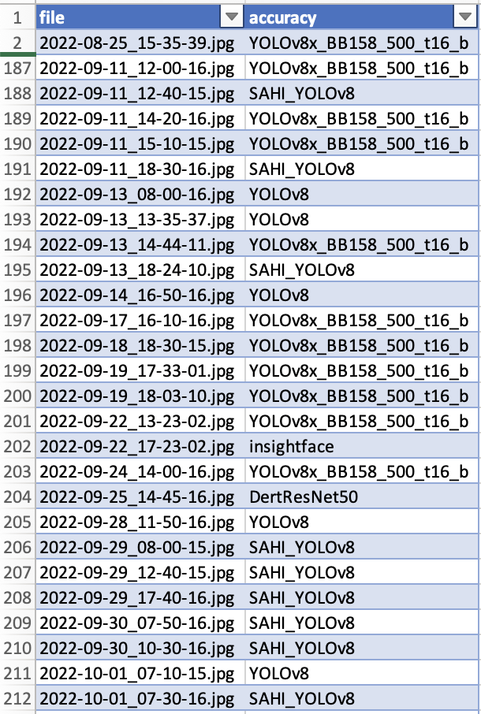
Image classification with labels
The same labels are hidden on the top of this classification ground truth table because the accuracy suggests the same result of YOLOv8x_BB150_500_t16_b.
The new classification model and the people counting model needed to deploy at the same time to match each other.

Slide 33
训练集，验证集，测试集
时间跨度，多少天
Hour 分布，白天黑夜都需要
人数统计，人多人少都需要
不能用 8 月夏天的训练数据，用 10 月的验证数据去验证，可能有雪
用 text compare 比对 train val test 三个文件夹文件顺序，不要有 duplicate 场景出现，最好交叉，互相不重复
训练集，验证集，测试集：天上的鸟，地上的鸟，水里的鸟，椅子，狗，各种沙滩，各种天气，各种光照条件
训练、验证、测试：平均每张 image 包含人数，数据集

Slide 34
【目标检测实战】检测器至少需要多少图像？
https://zhuanlan.zhihu.com/p/490793009
按照《How many images do I need》一文所提到：影响模型性能的数据量的拐点在每个类别包含150-500张图像，即在该拐点之前，数据量的提升对模型性能影响非常显著，超过该拐点后性能增益趋于平稳。

Slide 35
目标检测介绍（非常详细） http://c.biancheng.net/view/9851.html
FPN 采用 top-down 结构以及侧连方法，将深层特征和浅层特征进行融合，使得特征既包含全局信息又包含细节信息。另外，检测计算也基于特征金字塔的多层特征图，具有更强的多尺度适应性。基于 FPN 的 Faster R-CNN 算法在 COCO 数据集上取得了最优的性能。当前，FPN 已经成为构建检测算法的基础策略。
不过，YOLO 也有不尽如人意的地方，在目标位置的精度上比两阶段算法有所降低，尤其是在对一些小目标的检测方面，效果明显变差。正因为存在这些问题，后续 YOLO 的版本以及其他一阶段算法，都致力于更好地解决上述问题。

Slide 36
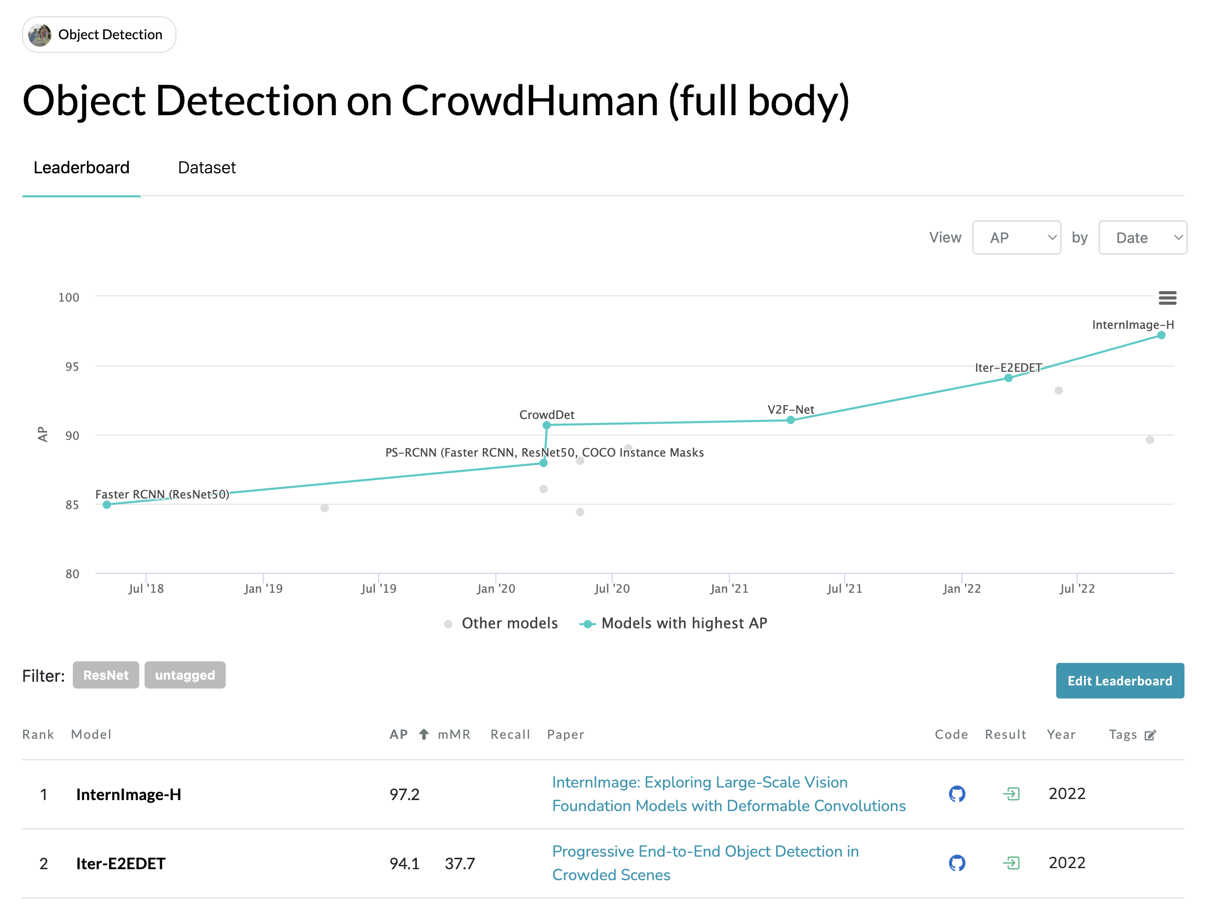
https://paperswithcode.com/paper/internimage-exploring-large-scale-vision

Slide 38
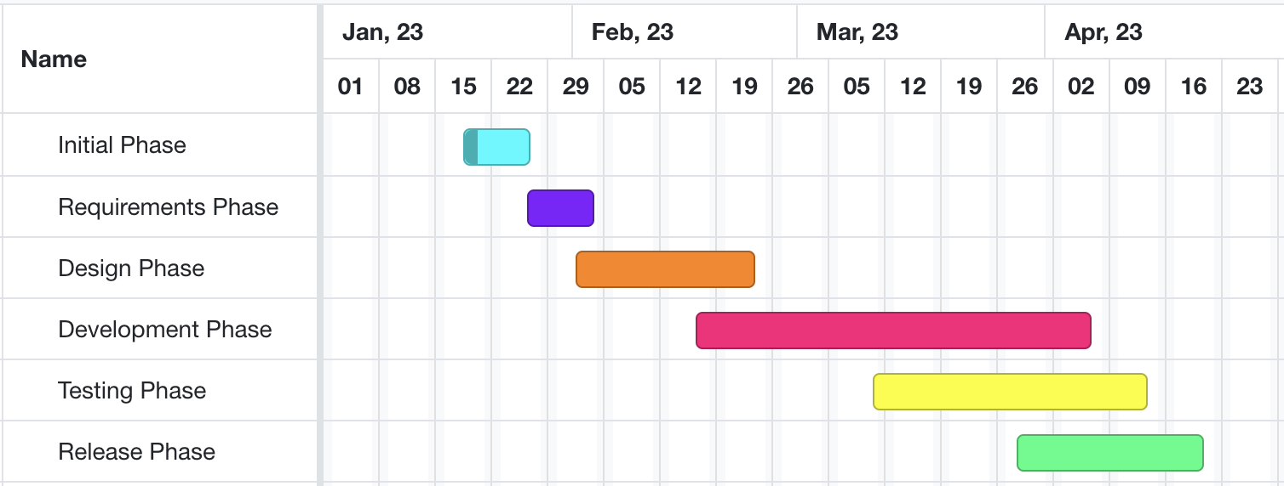
Developing and testing models on beach data
High-level GANTT Chart

Slide 39
Activities to be Completed before Next report:
Final model testing.
Project submission.
Notes:
Olexa, Peter (n.d.) A Person Making a Schedule. Accessed on January 18th, 2023 from https://www.pexels.com/photo/a-person-making-a-schedule-14299948/

Slide 40
Thank you!
Questions?
Notes:
Image: Leloo, The first (2022) https://www.pexels.com/photo/question-marks-on-paper-crafts-5428833/

